Slide 1


Least Squares (linier & non-linier), (Ordinary) Least Squares Specifications, Non-parametric Approach
Muhammad Akmal Farouqi
28/2/2024
www.ugm.ac.id
Locally Rooted, Globally Respected

Slide 2
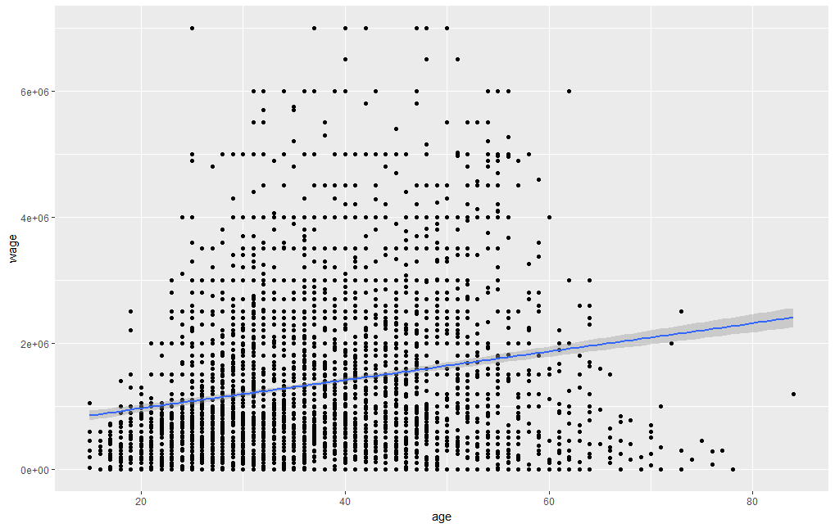

Least Square
The method of least squares is a parameter estimation method in regression analysis based on minimizing the sum of the squares of the residuals (a residual being the difference between an observed value and the fitted value provided by a model) made in the results of each individual equation.
$$\hat{Y}=a+bX+ε$$
However, there are potential bias issues happened when model can’t explain the chosen outcome variable.

Slide 3
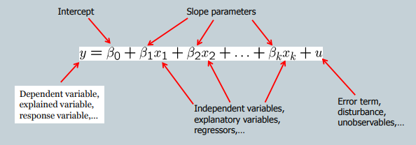



MLR
MLR allows us to explicitly control for many factors those simultaneously affect the dependent variable. Hence, the model able to predict better.
Moreover, MLR model is capable to include quadratic form variables because in some cases the relationship between variables aren’t linear!
Calculate turning point:
Source:http://www.ce.memphis.edu/7906/2014Fall/Lecture-5_v1.pdf

Slide 4
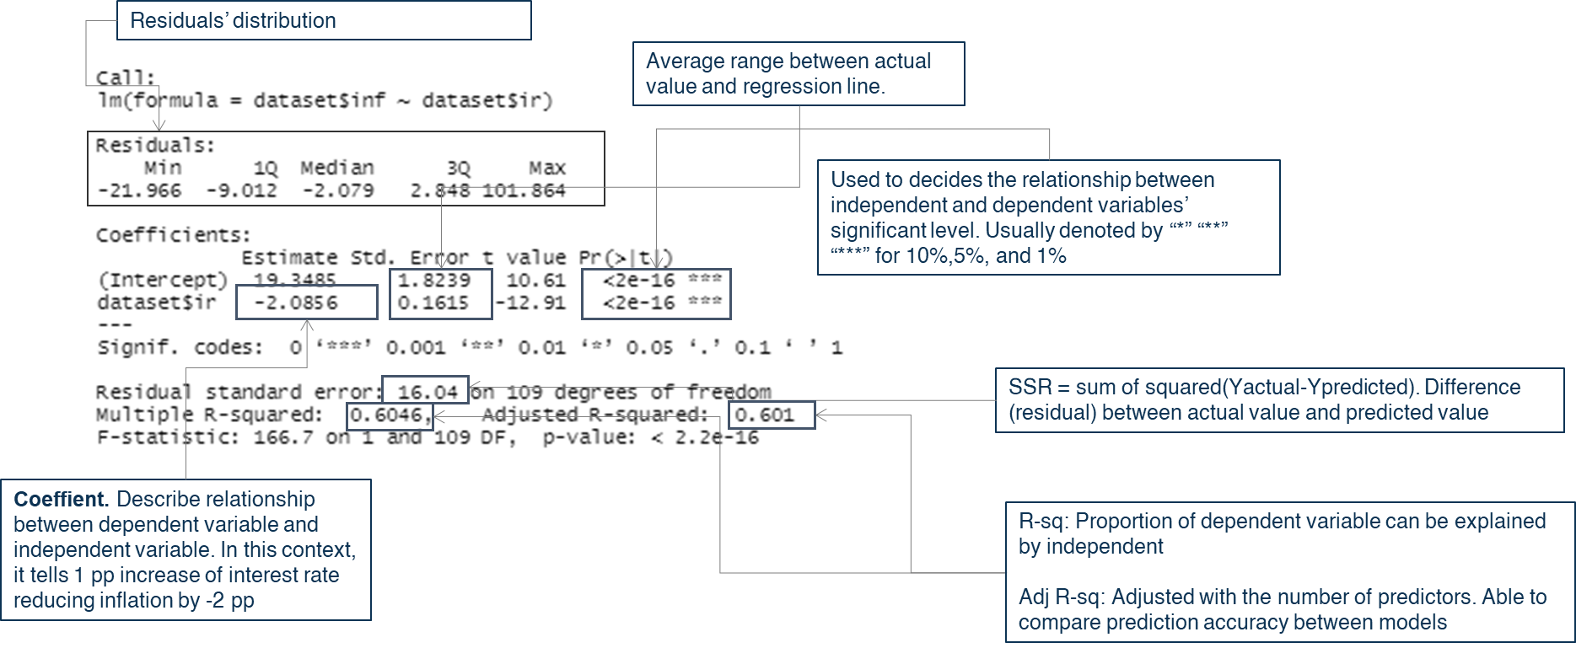
For more comprehensive explanation, please read: https://jonathanold.github.io/pdf/teaching/Interpreting_regression_tables.pdf

Slide 5
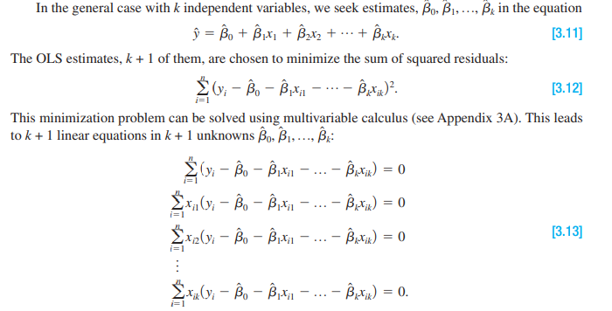
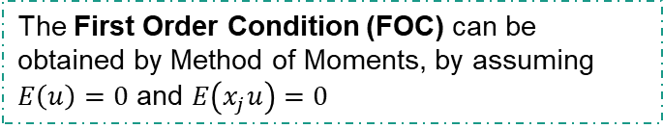
OLS
In statistics, ordinary least squares (OLS) is a type of linear least squares method for choosing the unknown parameters in a linear regression model by the principle of least squares: minimizing the sum of the squares of the differences between the observed dependent variable.
OLS estimation is solving minimization problem using method called OLS First Order Condition (FOC)
The First Order Condition (FOC) can be obtained by Method of Moments, by assuming $E\left(u\right)=0$ and $E\left(x_{j}u\right)=0$

Slide 6
Gauss-Markov
OLS able to produces unbiased linear and best estimator if satisfy Gauss-Markov assumptions consist of:
Linear in parameters
Random sampling
No perfect collinearity
Zero conditional mean
Homoskedasticity
Normality
Which can be tested in our model using several tests below:
Residual Normality Test: satisfying this assumption allows you to perform statistical hypothesis testing and generate reliable confidence intervals and prediction intervals. However, OLS does not require that the error term follows a normal distribution to produce unbiased estimates with the minimum variance. (jarque-berra test, saphiro-wilk test)
Homoscedasticity Test: The variance of the errors should be consistent for all observations (Breusch-Pagan)
Autocorrelation Test: One observation of the error term should not predict the next observation. For instance, if the error for one observation is positive and that systematically increases the probability that the following error is positive, that is a positive correlation (durbin-Watson)
Multicollinearity Test: Ordinary least squares cannot distinguish one variable from the other when they are perfectly correlated example: X = 0.5Y (VIF test)
Linearity Test: Testing whether the linear model specification is the correct model (Reset Test)

Slide 7
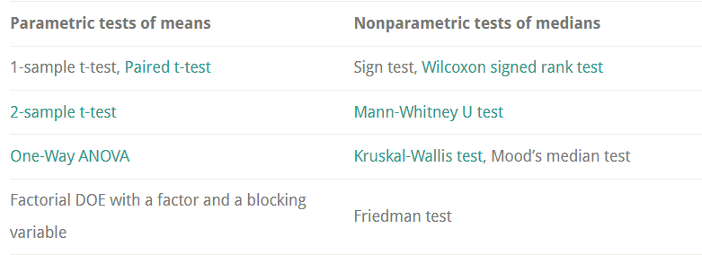
Non-parametric Analysis
Nonparametric statistics is a type of statistical analysis that makes minimal assumptions about the underlying distribution of the data being studied.
Advantages of non-parametric analysis:
Nonparametric tests assess the median which can be better for some study areas
Nonparametric tests are valid when our sample size is small and your data are potentially nonnormal
Nonparametric tests can analyze ordinal data, ranked data, and outliers
Kruskal Wallis:
https://www.statology.org/kruskal-wallis-test-in-r/
Wilcoxon signed rank test:
https://www.statology.org/kruskal-wallis-test-in-r/

Slide 8
Thank You

